Slide 1
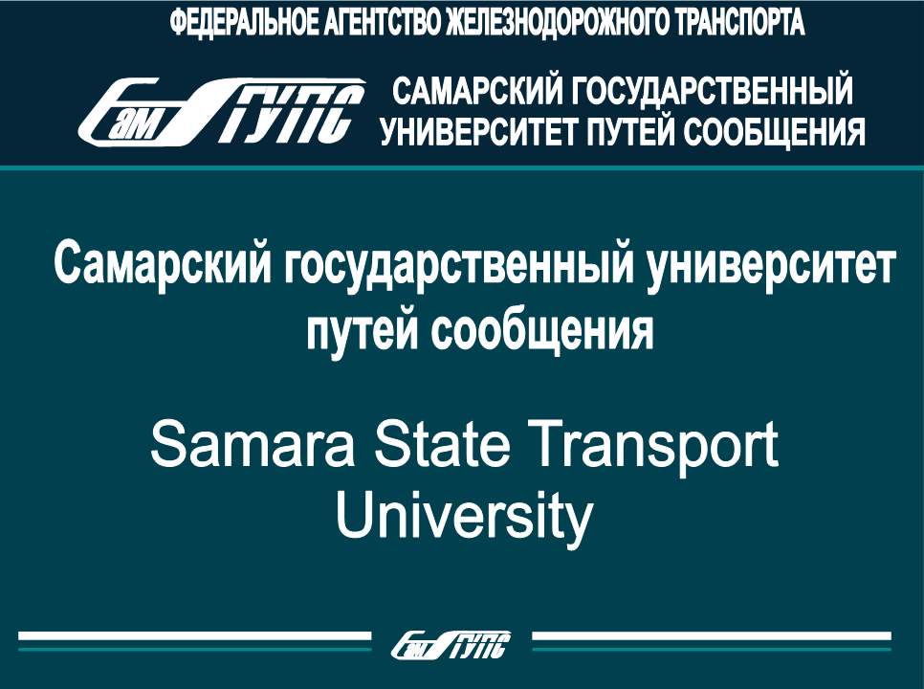
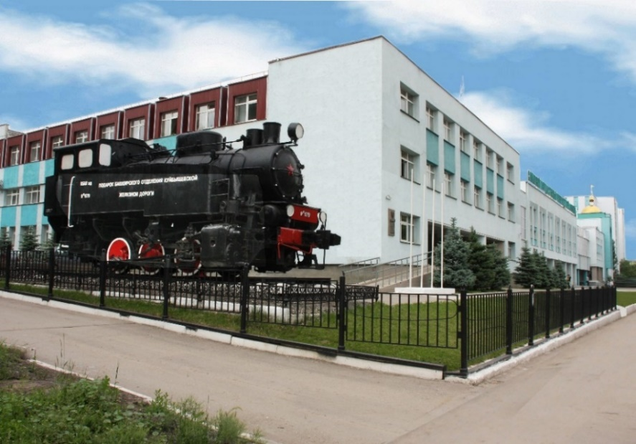
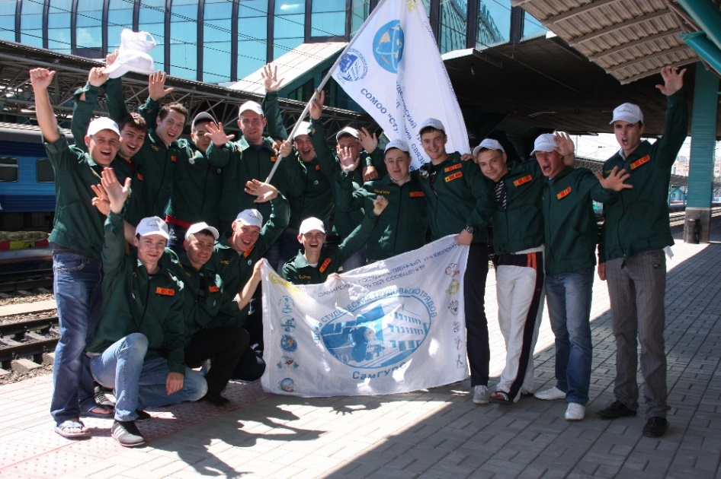
Internationalization in Samara State Transport University
Rector of SSUT Doctor of Engineering Zheleznov Dmitrii

Slide 2
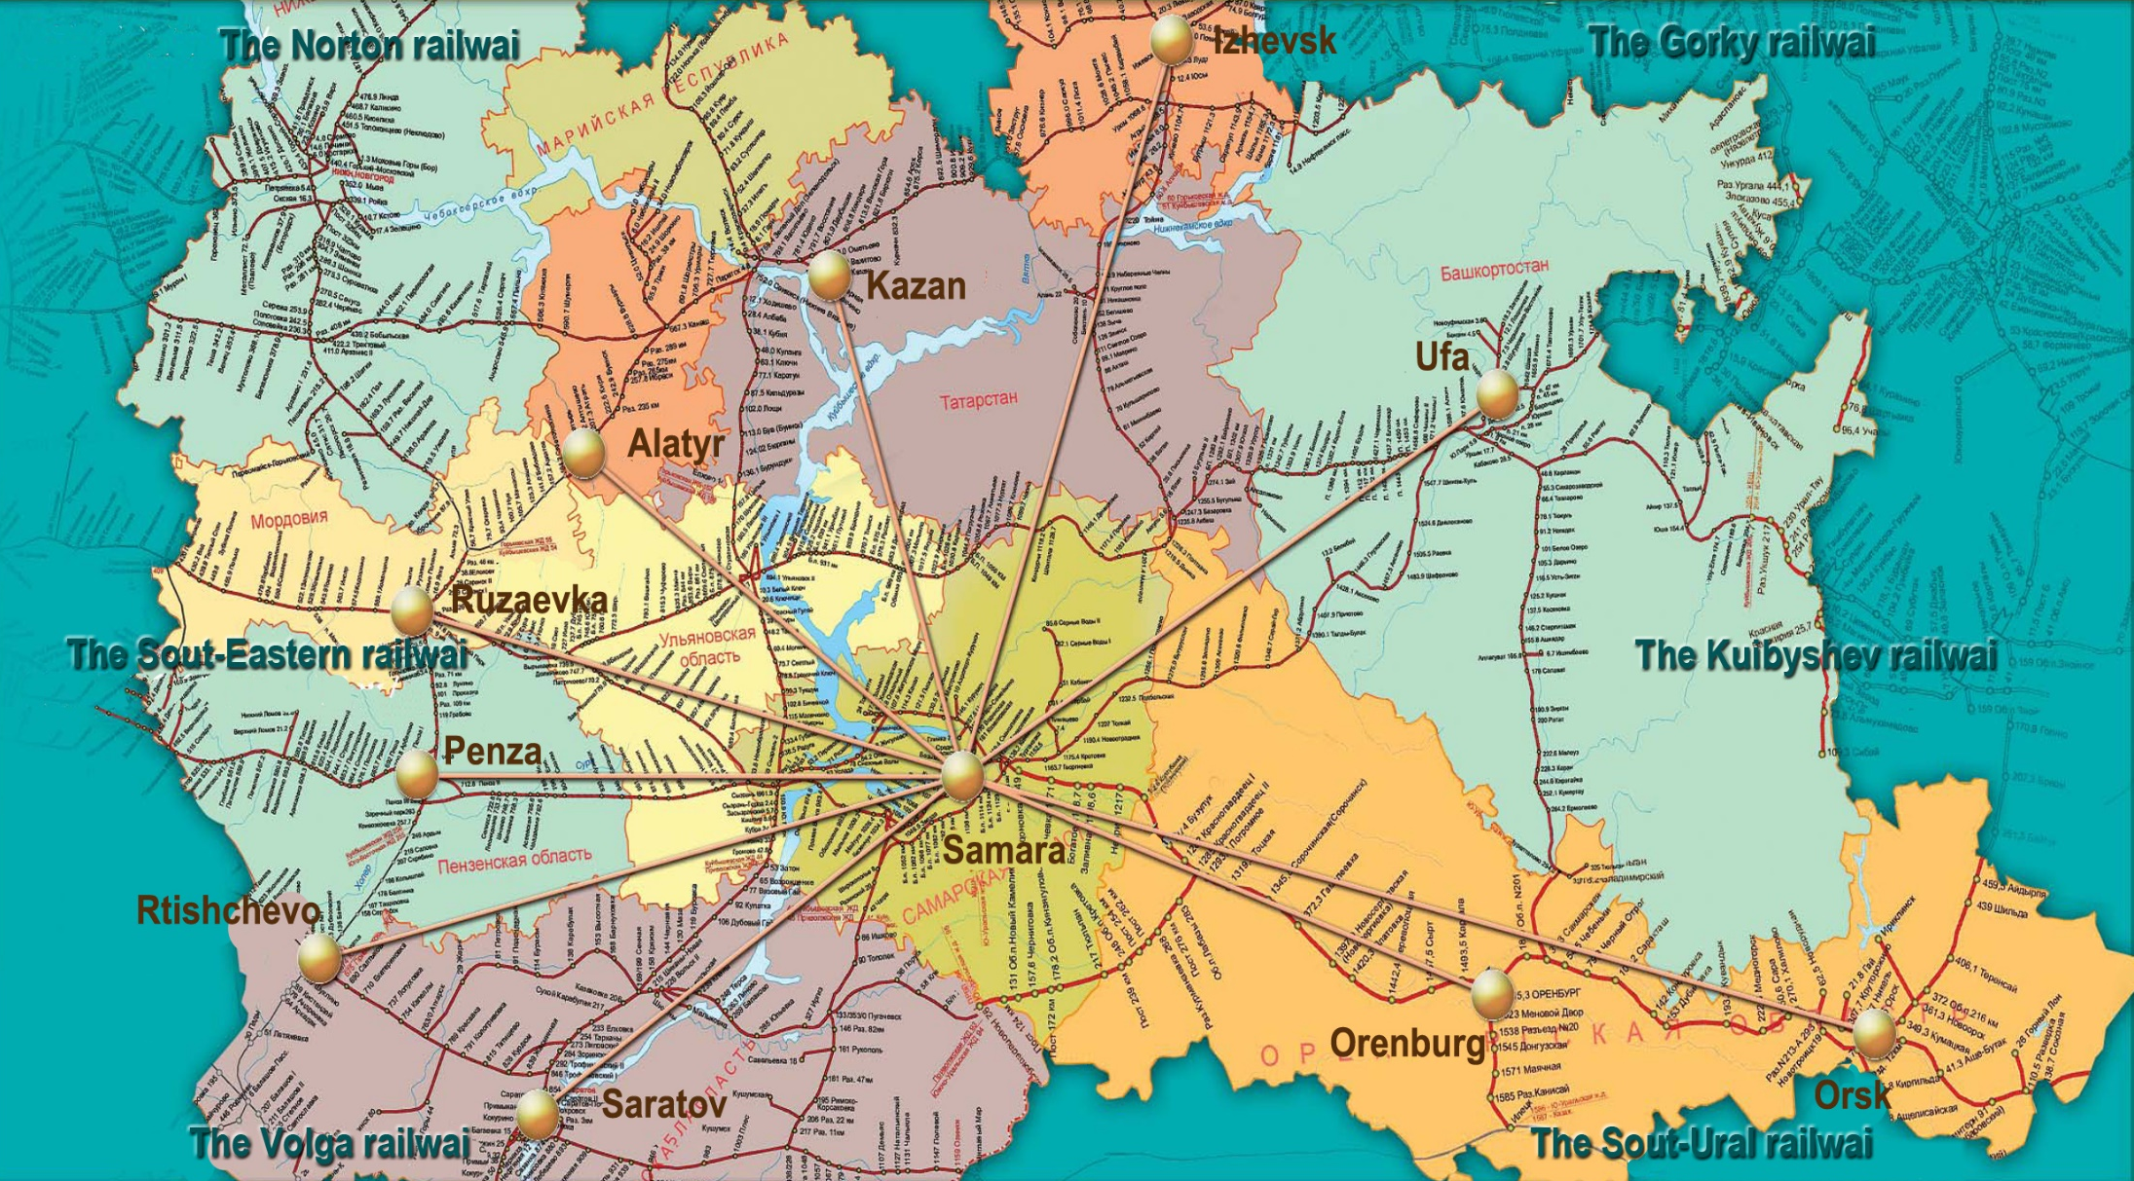
SSTU in Volga Federal District
2

Slide 3
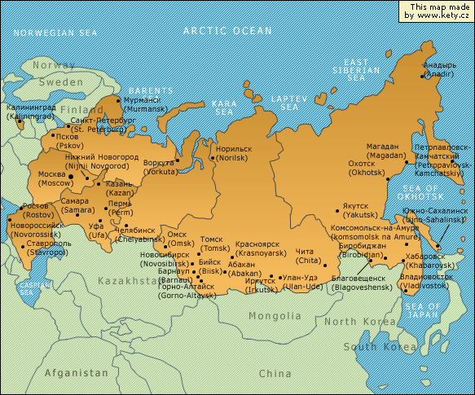
SSTU in the map of Russian Federation
Екатеринбург
3

Slide 4
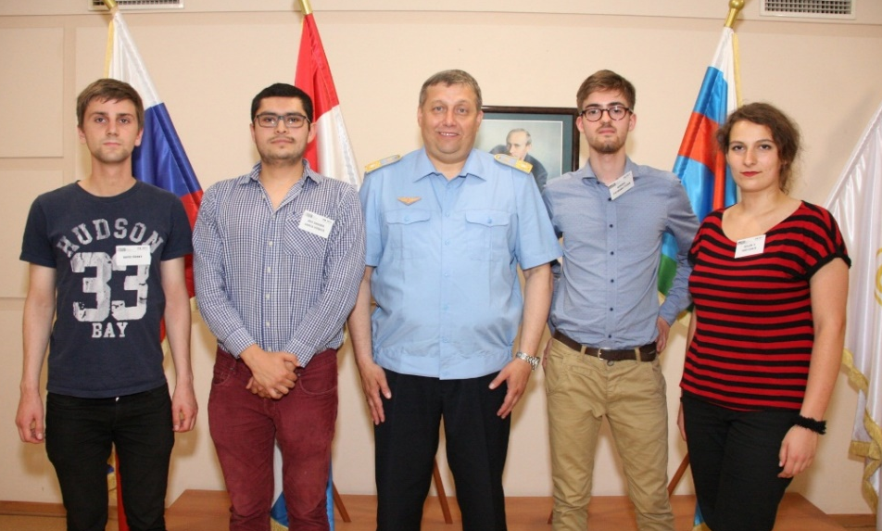

The main indicators of internationalization in SSTU
- Supporting of switch to marks of workload
for all specialties in credit points.
- Education quality control.
- Budget Fund from international grants
and projects.
- Diplomas for Russian and foreign students
as professional translators.
- Publications in foreign editions and publishing houses, publishing co-work with
foreign partners.
- Treaty-making with foreign universities and research centers.
- Participating of students and post graduated students in international exchange
with foreign universities.
4

Slide 5
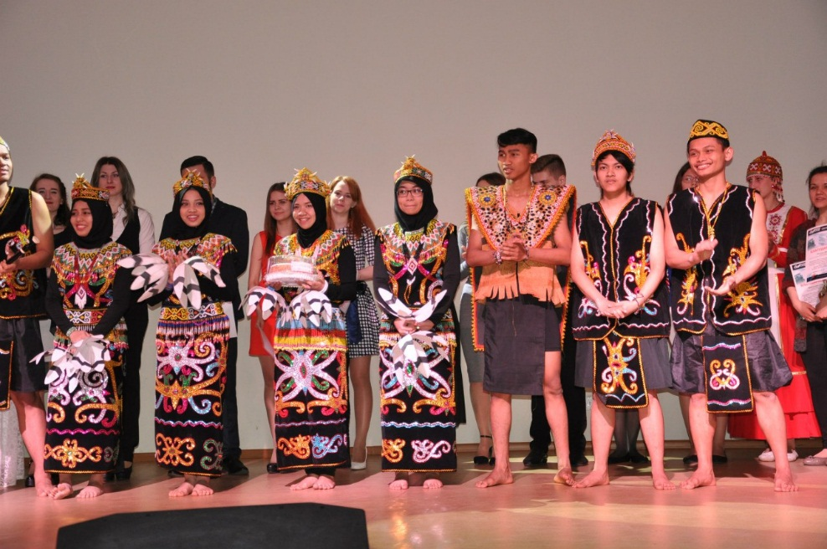
The main indicators of internationalization in SSTU
- Increase of foreign students in SSTU.
- Participating of graduate students in
scientific conferences in the university.
- Participating of foreign students in
amateur performances, sport events,
student self-governance.
- Participating of SSTU in international educational exhibitions, promotional
and PR activities for foreign countries.
- Increase of finances for international activities and other parts of internationalization of SSTU.
5

Slide 6





























International relationship of SSTU
Years | Foreign countries
2004-2006 | Germany, South Korea, Poland, Great Britain, France, Austria
2007-2008 | Czech Republic, Mongolia, Sweden, USA, Slovakia, Kazakhstan
2009-2010 | Armenia, Hungary, Iceland, Belarus, Georgia
2011-2012 | Spain, Vietnam, Bulgaria, Brazil
2012-2013 | China, Turkmenistan, Ukraine, Slovenia
2014-2015 | Indonesia, Italy, India, Norway
6

Slide 7
Increase of SSTU foreign partners
7

Slide 8

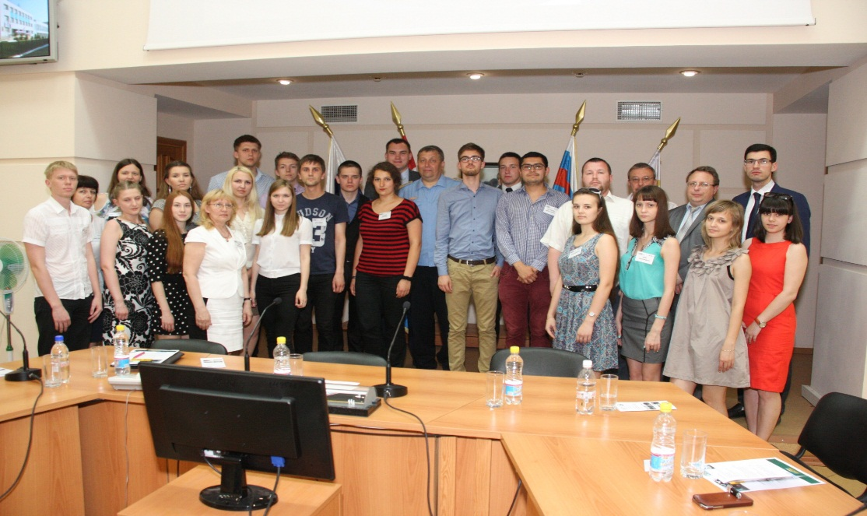
TEMPUS. Grants of SSTU
2005-2007 – JEP_25039_2004
«Curriculum in mechatronics.
Development and implementation»
2007-2009 – JEP_27066_2006
«Intercultural marketing»
2014-2016 – JEP_544024_2013
«Environmental Audit»
8

Slide 9


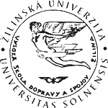


Other TEMPUS participants
- Dresden Technical University (Germany)
- Czestochowa Technological University (Poland)
- University of Zilina (Slovakia)
- Maribor University (Slovenia)
- Omsk State Transport University
- Ural State Transport University
- Tyumen State Oil and Gas University
9

Slide 10
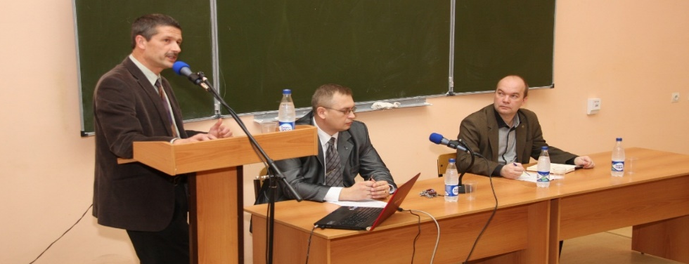
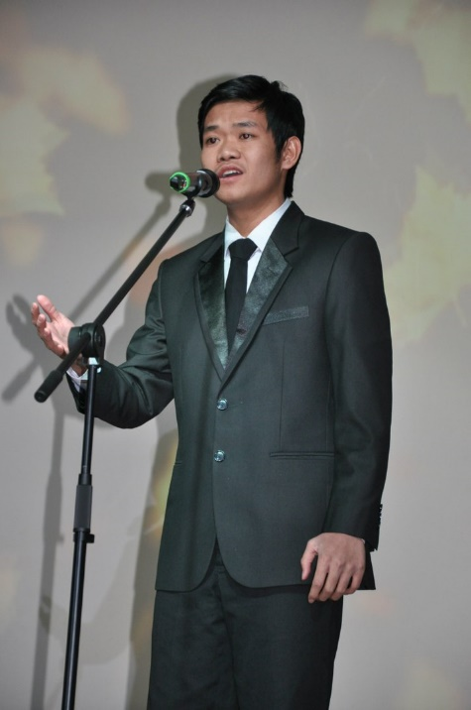
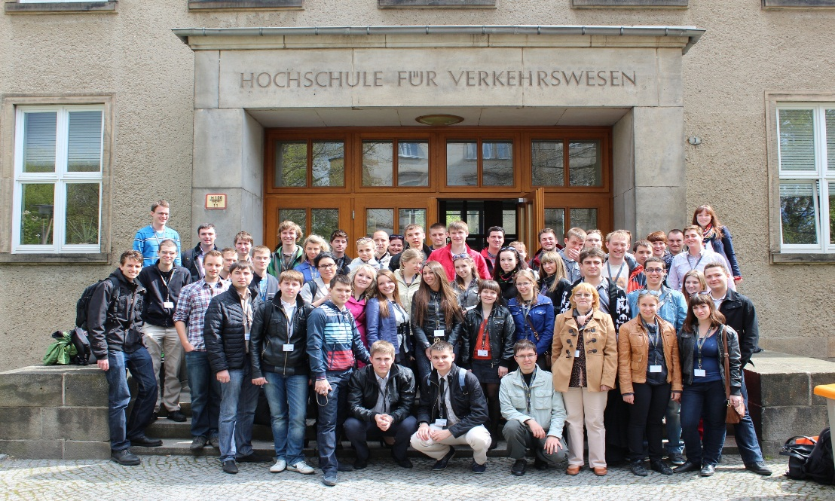
Participation of student and teachers in international events
10

Slide 11
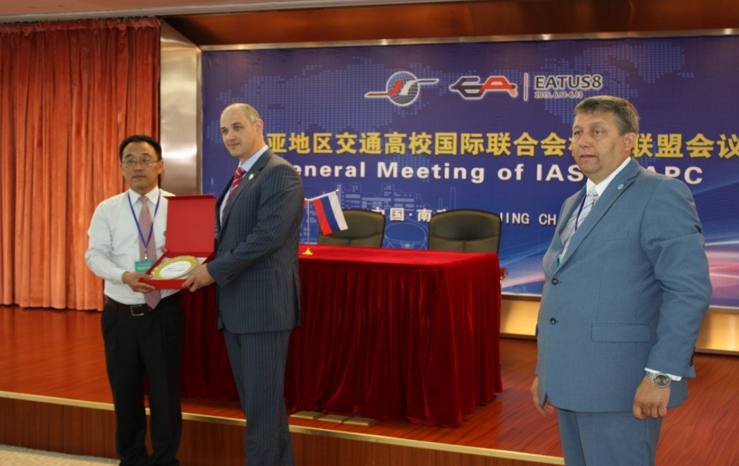

Cooperation with China
11

Slide 12


Other foreign partners of SSTU
- EACEA - Executive Agency Education, Audiovisual and Culture - DAAD – German Academic Exchange Service - ZAV – Zentralstelle für Arbeitsvermittlung – employment of students in Germany during the summer holidays - Work&Travel - employment of students in USA during the summer holidays - IREX - International Research & Exchanges Board - Fulbright – grants for teachers from Russia
12

Slide 13
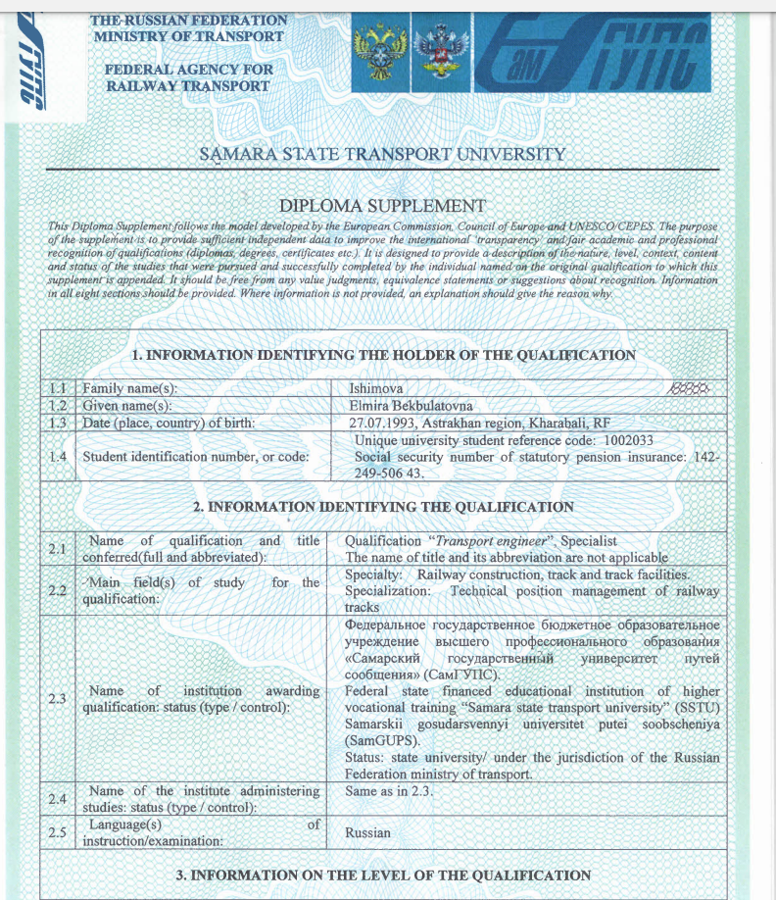
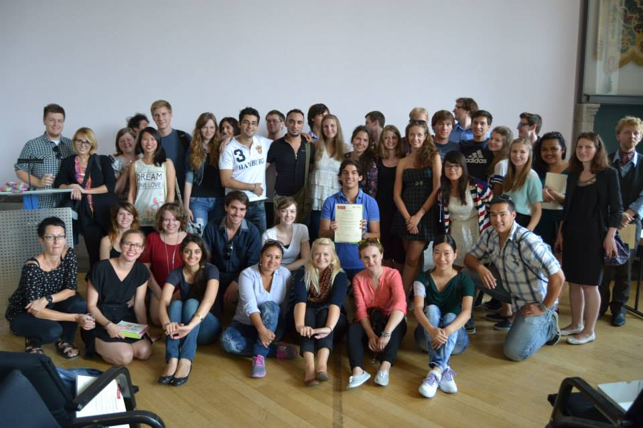
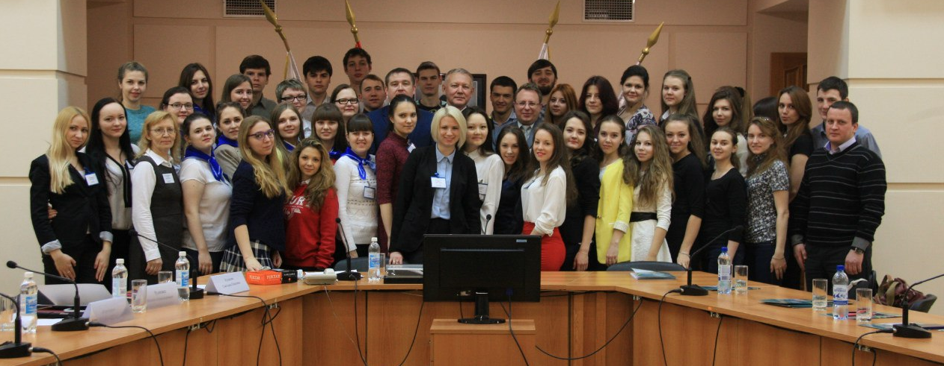
Training of foreign students
13

Slide 14
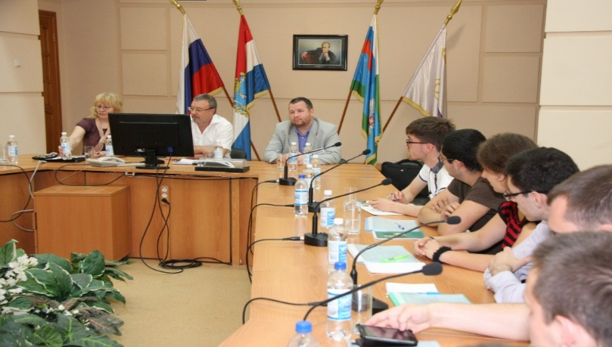
Development of internationalization in SSTU
1. Development of student and academic mobility through scholarships, implementation of programs of academic exchanges and joint educational programs.
2. Attracting high-skilled foreign teachers .
3. Attracting foreign students.
4. Cooperation with foreign and Russian
partners for joint research projects.
5. Publication of research results of SSTU in foreign indexed journals.
14

Slide 15
Thank you for attention!

